Slide 1

Recovery Model
16 May 2024
Adrien Perello
Leiden University

Slide 2
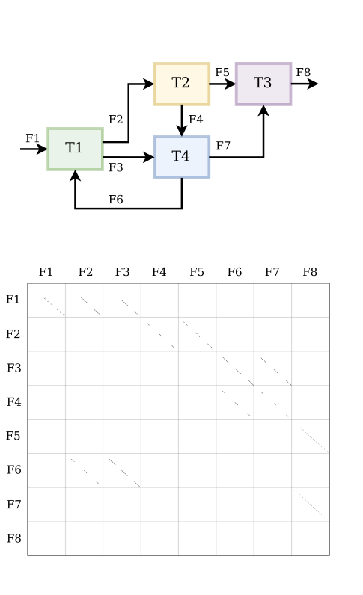
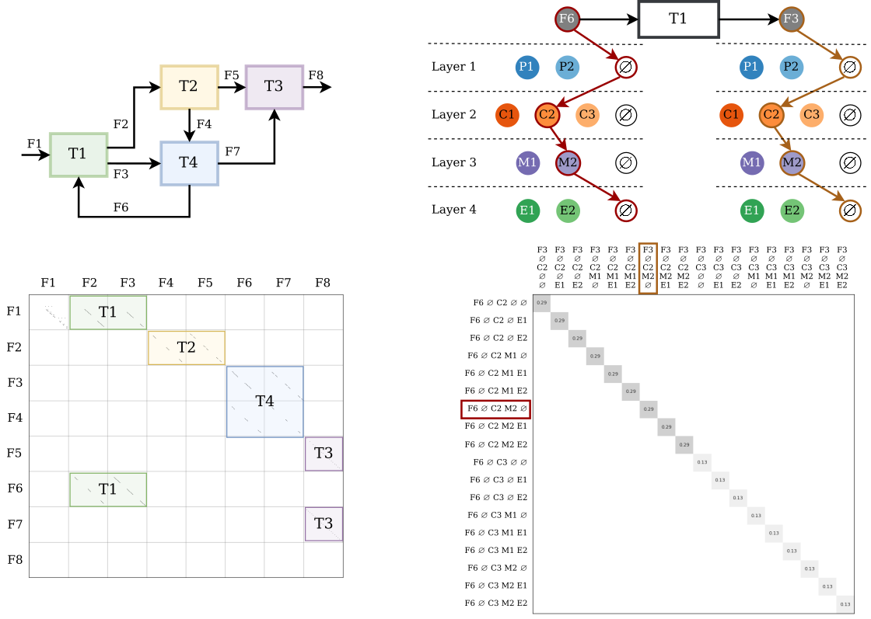

Mass
derived from
input mass
Mass transferred to
TCs
+
What we want to know
input
composition
A
y

Slide 3
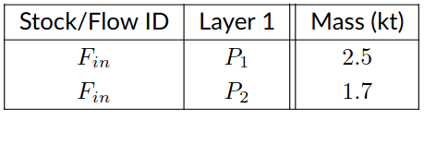
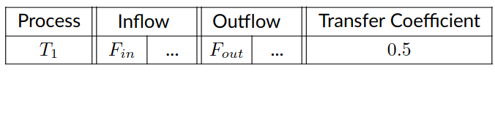
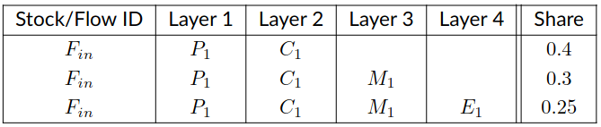
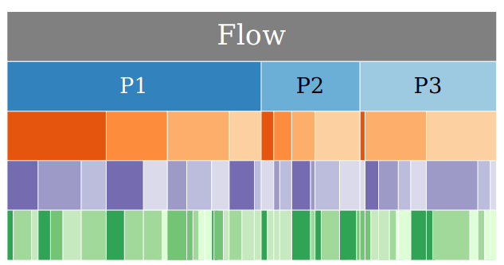
input mass
TCs
The only things the model needs from each WS
input composition (nb layers is flexible)
input mass
TCs
+
input
composition

Slide 4
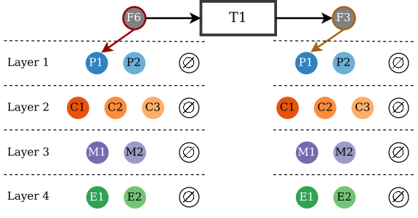
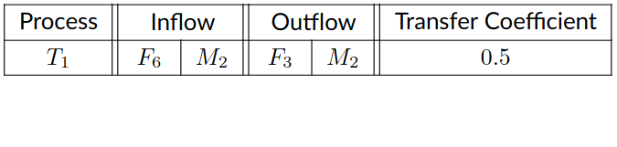
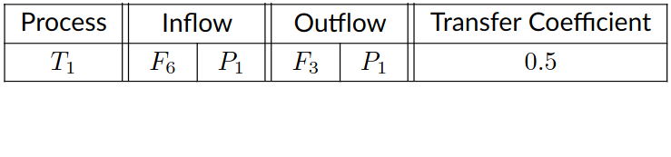


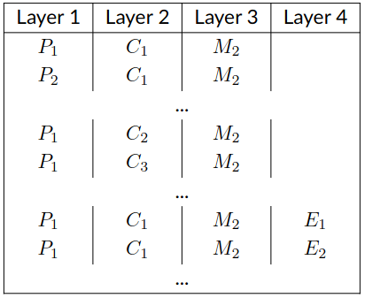
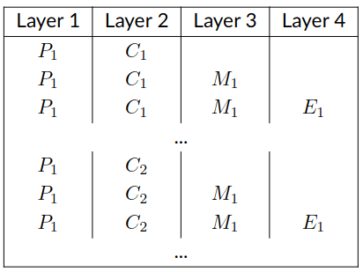
TCs
what
row(s) ?
what
column(s) ?
from The TC file
… to building the system matrix
SPARSE MATRIX
(only store non 0 entries)
+
No data reconciliation (consolidation step instead)
+

Slide 5
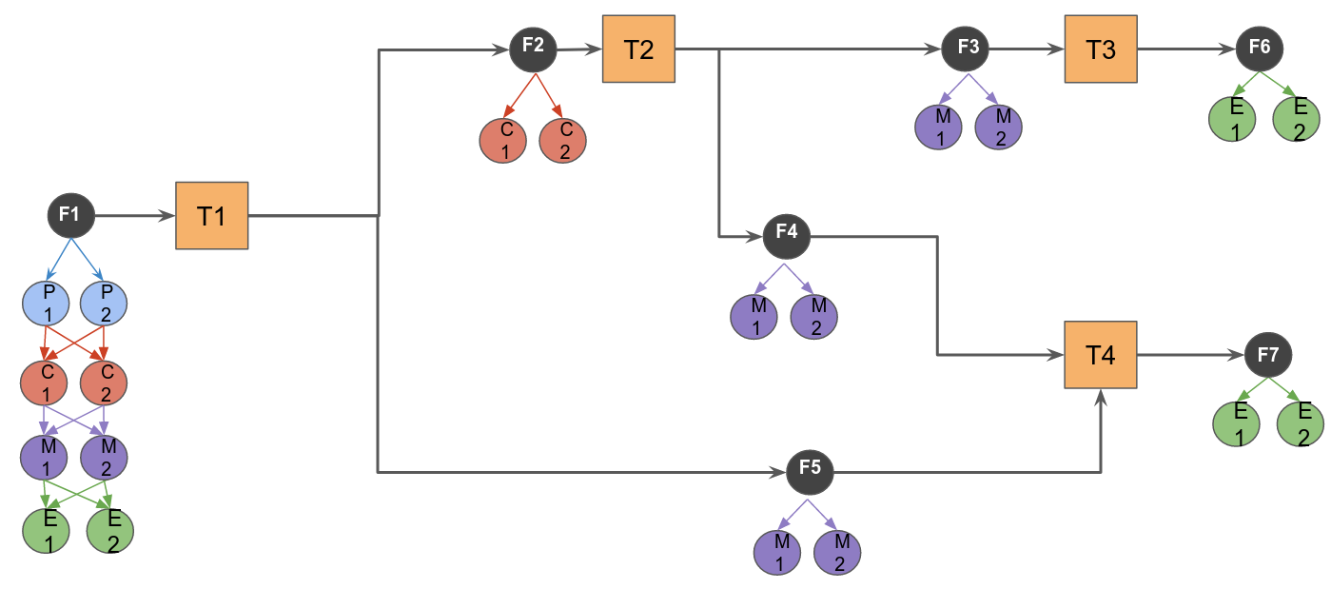
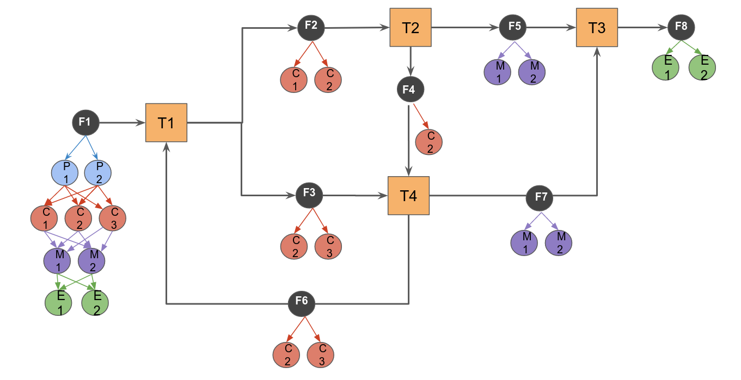
Example 1
Example 2
Dimensions = (8, 3, 3, 3, 3)
Matrix size: 648 x 648
Equation setup: 0.7s
Equation solving: 0.15s
Dimensions = (8, 3, 4, 3, 3)
Matrix size: 864 x 864
Equation setup: 0.85s
Equation solving: 0.19s
Laptop with Intel Core i7 10th gen (1.80GHz × 8) and 16GB DDR4 RAM.

Slide 6
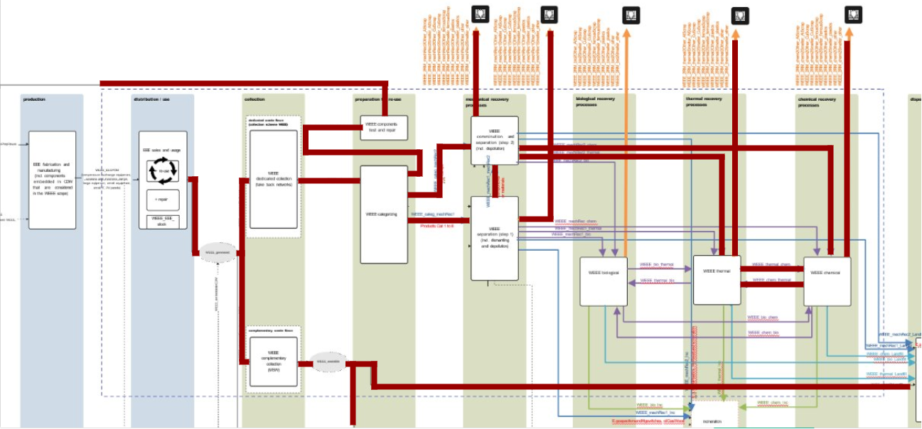
Example 3 (with fake data)
Dimensions = (19, 8, 83, 31, 18)
Matrix size: ~ 7.10⁶ x 7.10⁶
Equation setup: 10.3s
Equation solving: 22.6s
Memory (RAM) error at
~ 12.10⁶ x 12.10⁶ (+13 flows)
Laptop with Intel Core i7 10th gen (1.80GHz × 8) and 16GB DDR4 RAM.

Slide 7
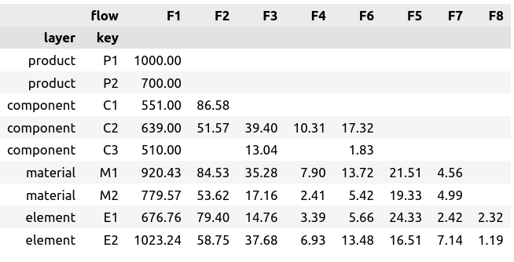
Aggregated results

Slide 8
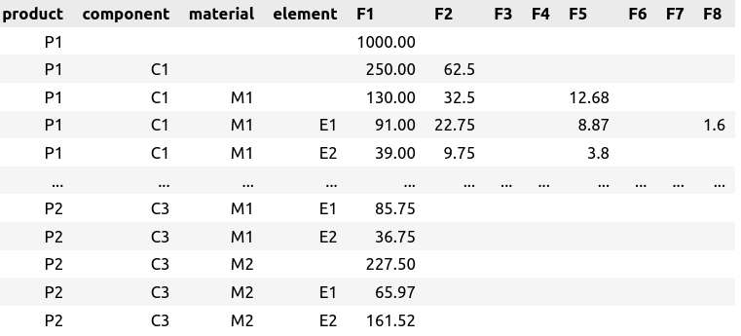
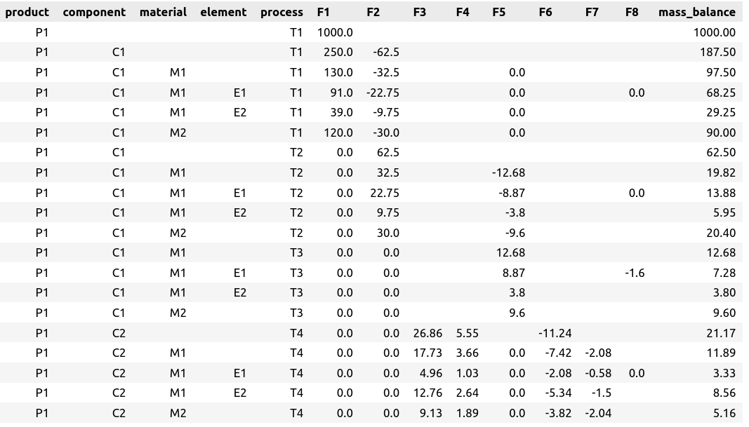
Disaggregated results
…
…
…
…

Slide 9
And now?
Next step:
Handle RAM limitations
Alignment with WP6 (formatting model output)
From fake data to real case study
WS workshops for using model/feedbacks
Open questions:
Data ranges? Quality?
1 process = multiple technologies

Slide 10
Appendix

Slide 11
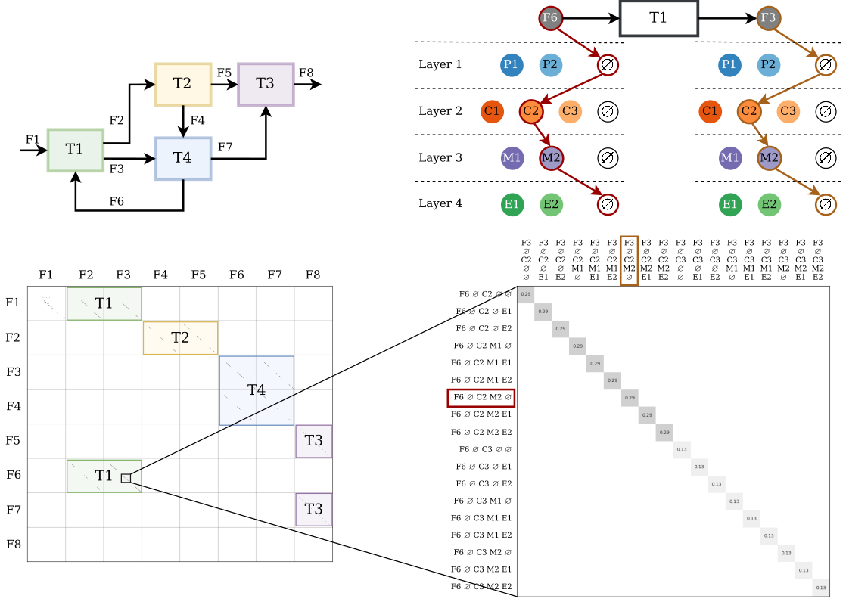


0.29
A

Slide 12
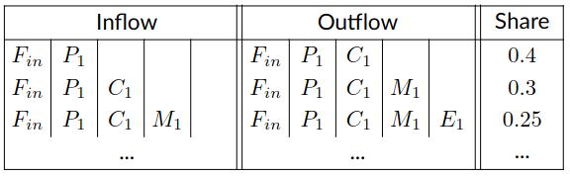
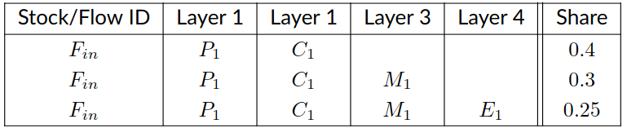
input composition

Slide 13
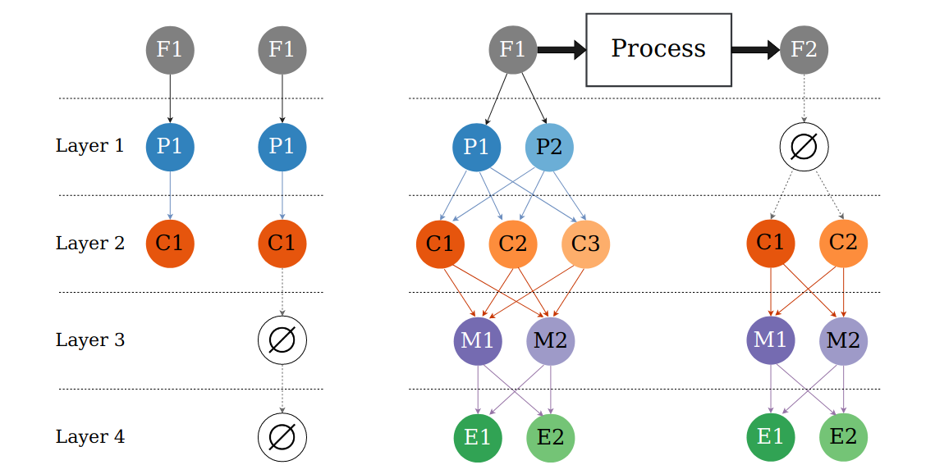
The symbol ∅ is used to maintain a fixed length tuple (F, P, C, M, E)
when considering an aggregated entity (left) or when an upper level is no longer present (right).

Slide 14
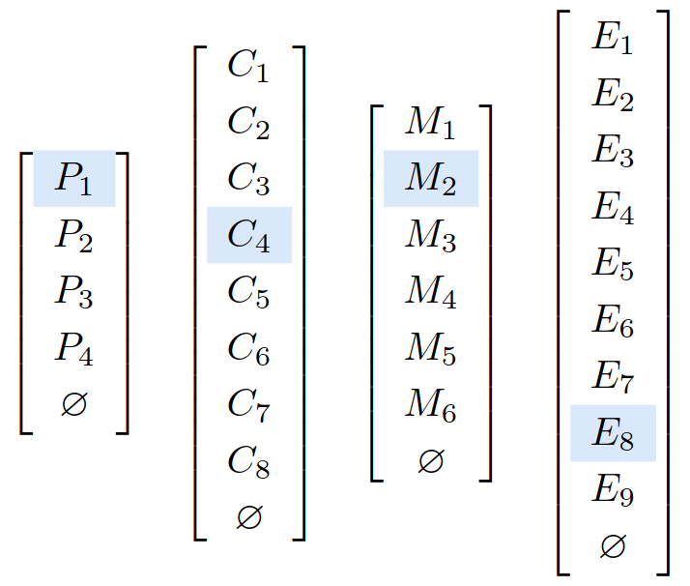
P1, C4, M2, E8 → index = 1428

Slide 15
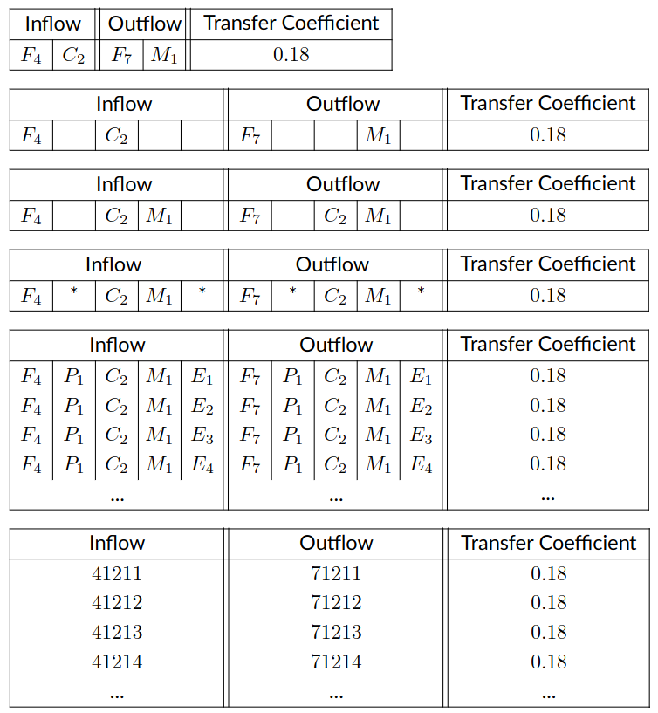
Inferences made when processing the TC file

